Slide 1
OPERATIVE DELIVERY
Dr. Ali F. Al-Assadi
Prof. of Obstetrics & Gynecology
FICOG, CABOG, ARCOG

Slide 2
Aim
Types of operative delivery
Indications.
Procedures.
Complications.

Slide 3
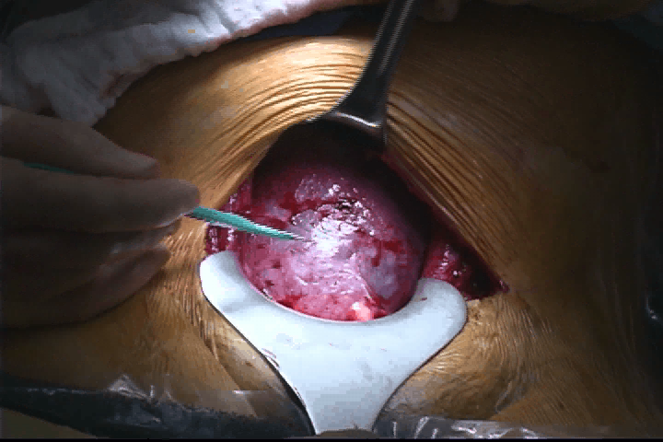
CAESAREAN SECTION:
It is defined as delivery of the fetus through incision in the anterior abdominal & uterine walls.

Slide 4
INDICATIONS:
1-maternal/fetal: Dystocia (CPD, failed induction of labor, abnormal uterine action).
2-Maternal:Eclampsia/ severe PE, HELLP syndrome, DM, Cardiac disease, Cervical ca., previous uterine surgery& obstruction to the birth canal(fibroid, ov. Tumor).
3-Fetal: fetal distress, cord prolapse, malpresentation (Breech, T-lie, and brow), fetal abnormalities (gastroschisis, omphalocele).
4-Placental:placenta previa & abruption placentae.
The most frequent indication for cs is Dystocia, which usually present as failure to progress in labor.

Slide 5
TYPES OF OPERATION
The type refers to the uterine incision rather than the skin incision.
1-lower segment cs ( transverse incision in the lower segment of the uterus)
2-upper segment cs ( classical cs, vertical upper segment incision).
3- vertical lower segment cs (De Lee incision).

Slide 6
The usual operation is lower segment cs, classical cs is indicated in the followings:
when preterm fetus presents by breech ( De Lee op.).
when the fetal lie is transverse.
when access to the lower segment is restricted because of fibroid or rarely dense adhesions.
when hysterectomy will immediately follow the cs .
postmortem cs.
when invasive cx ca is present.

Slide 7

Lower segment CS

Slide 8
MORBIDITY & MORTALITY
The risk of maternal death from cs is 4-6 times greater than from vaginal delivery. the overall M.R. from cs is currently < 1:1000. the complications are:
hemorrhage.
Postoperative sepsis.
Injury to the nearby structures.
Thromboembolic disease.

Slide 9
CAESAREAN HYSTERECTOMY
Mean removal of the uterus at time of cs this may be life saving in cases of:
PPH not responding to conservative treatment.
ca cx
plcenta percreta
severe damage to the uterus from rupture.

Slide 10
OBSTETRIC FORCEPS
It is a tool designed to provide traction, rotation or both to the fetal head when the unaided expulsive efforts of the mother are insufficient to accomplish safe delivery.
TYPES:
Traction : has cephalic & pelvic curves eg. Simpson.
Rotation & traction : has cephalic curve only ( Kielland).

Slide 11
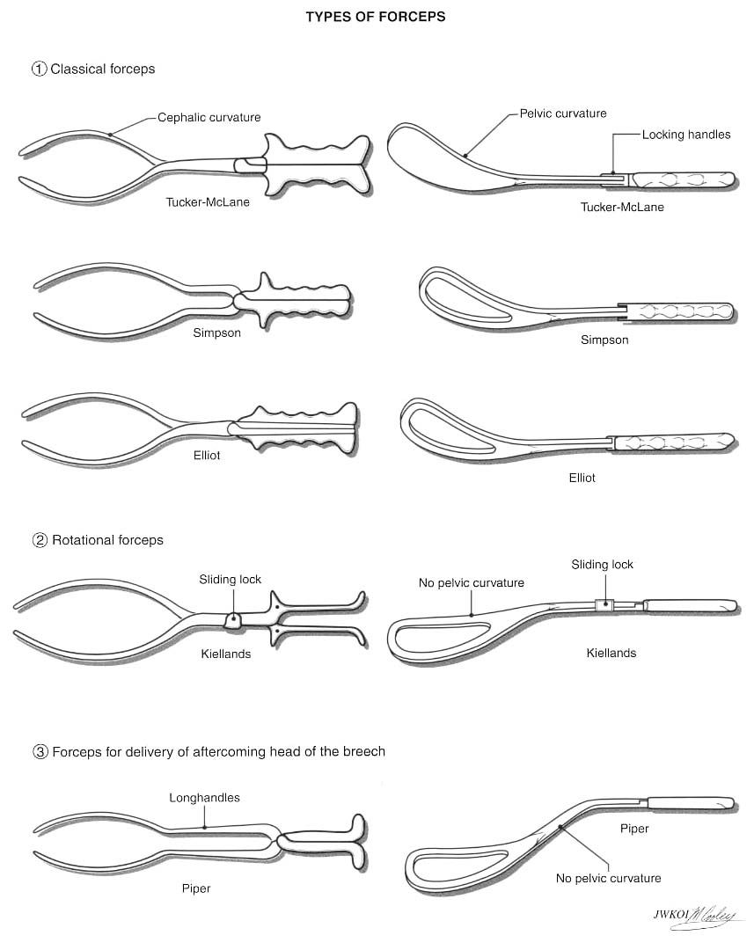
Classification of Forceps

Slide 12
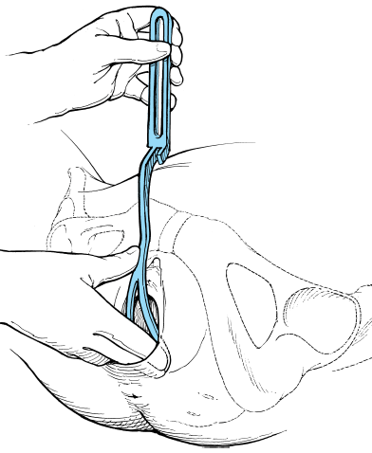
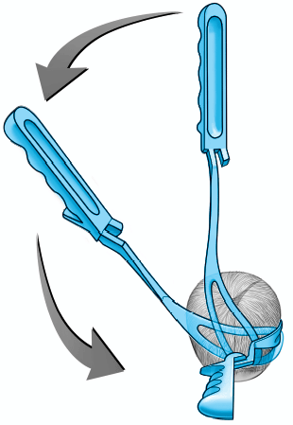
Williams Obstetrics - 22nd Ed. (2005)

Slide 13
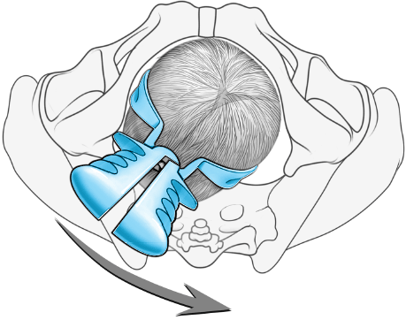
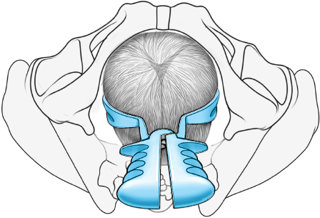
Williams Obstetrics - 22nd Ed. (2005)

Slide 14
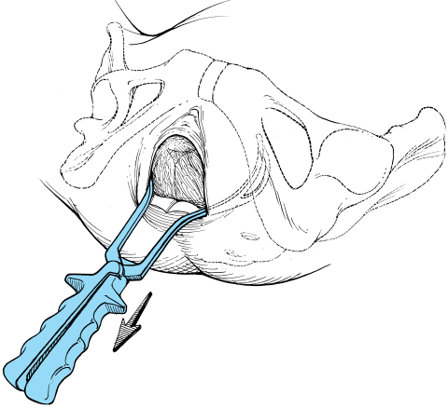
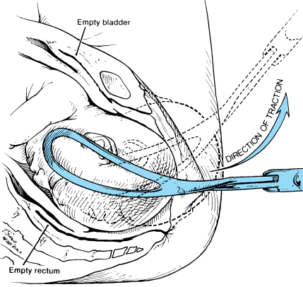
Williams Obstetrics - 22nd Ed. (2005)

Slide 15
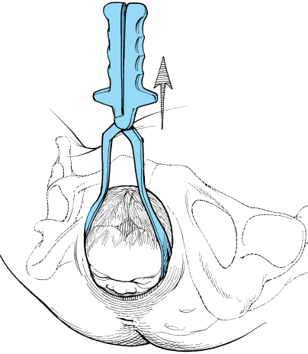
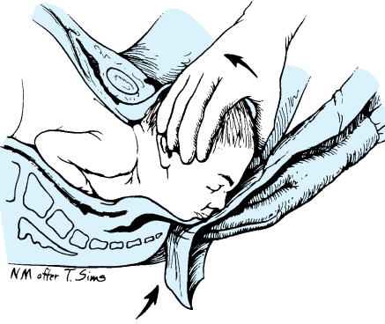
Williams Obstetrics - 22nd Ed. (2005)

Slide 16
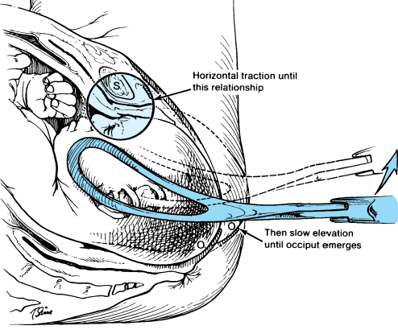
Williams Obstetrics - 22nd Ed. (2005)

Slide 17

Forceps Delivery

Slide 18
INDICATIONS
The most frequent indication is delay in the second stage of labor caused by abnormal uterine action or failure of the head to rotate adequately.
Maternal conditions eg. H.T., cardiac dz., pulmonary dz., in which strenuous pushing in the 2nd stage is hazardous
Fetal distress is a frequent indication.
Delivery of the after coming head in a vaginal breech delivery.

Slide 19
REQUIREMENTS FOR FORCPS DELIVERY
The head is fully engaged.
The position of the head should be determined.
The presenting part must be suitable ( Vx, face, after coming head in breech).
No CPD.
The cx is fully dilated & the membranes ruptured.
The bladder has been emptied.
Analgesia & anesthesia is sufficient for Pt. comfort.
Uterine contractions must be present.

Slide 20
COMPLICATIONS
Maternal: injury to uterus, cx &vagina.
Fetal: injury to face & cranium ( laceration, bruising & serious intracranial injury).

Slide 21
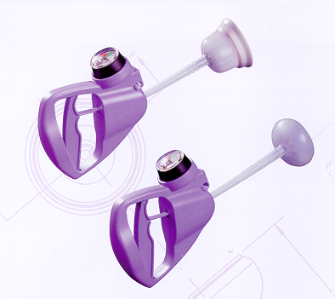
VACUUM EXTRACTER
It is an instrument that employs a suction cup applied to the fetal head. Traction is applied to the cup to aid the mother's expulsive efforts.

Slide 22
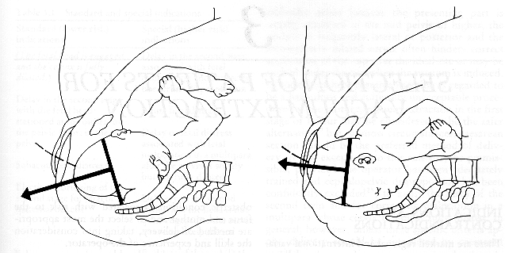
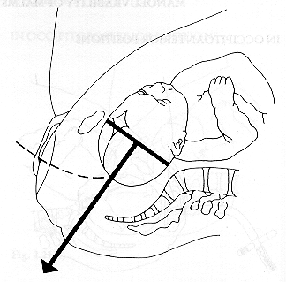

Slide 23
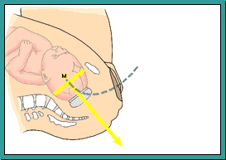
Axis Animation

Slide 24
Vacuum Extractor Delivery

Slide 25
It has the following advantages over forceps:
Unlike forceps, it does not occupy space adjacent to the fetal head.
Delivery of a fetus in OP or occipito-transverse position doesn't require forced rotation of the head.
It increases the head flexion.
Attempted delivery with the vacuum in the presence of unrecognized disproportion will result in the loss of suction & failure of the procedure.

Slide 26
REQUIRMENT FOR VACUUM EXTRACTION
Are the same as those for forceps with the following exceptions:
Although generally the cx should be fully dilated, it can be used in multiparous women in whom a small rim of cx remains.
The vacuum extr. Is contraindicated in preterm delivery.
It must never be used in face & breech presentation.

Slide 27
COMPLICATIONS
vaginal lacerations,
fetal scalp injuries (lacerations, subaponeurotic hemorrhage).

Slide 28
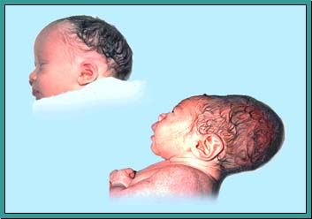
Molding

Slide 29
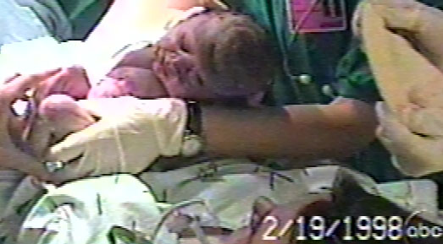
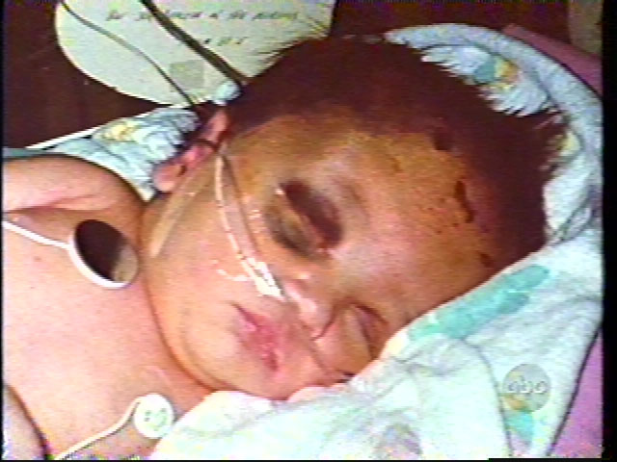
Subgaleal Hematoma

Slide 30
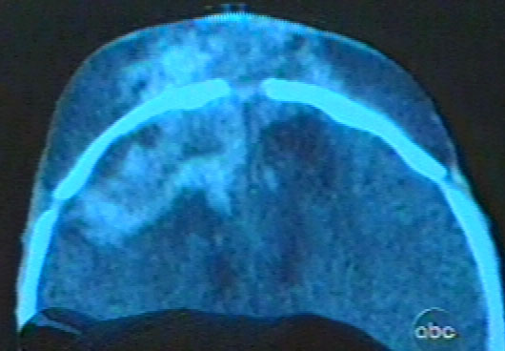
CT of Subgaleal

Slide 31
Any ?
Thank you

